Slide 1
Inner workings of unity 3d
Notes:
Hey everyone, how many of you have played a video game? Great, every one of you rose your hands. Today we’re going to be exploring the inner workings of video games, specifically using the game engine Unity.

Slide 2
What we are going to cover
Intro to Unity
Physics & Game Objects
Cameras & Lighting
Textures & Materials
Quaternions and Rotation
Vector3’s & Coordinates
Intro to JavaScript
Functions
Logic Statements
Unity Level Design Demo

Slide 3
Project timelapse
*embedded video here*

Slide 4
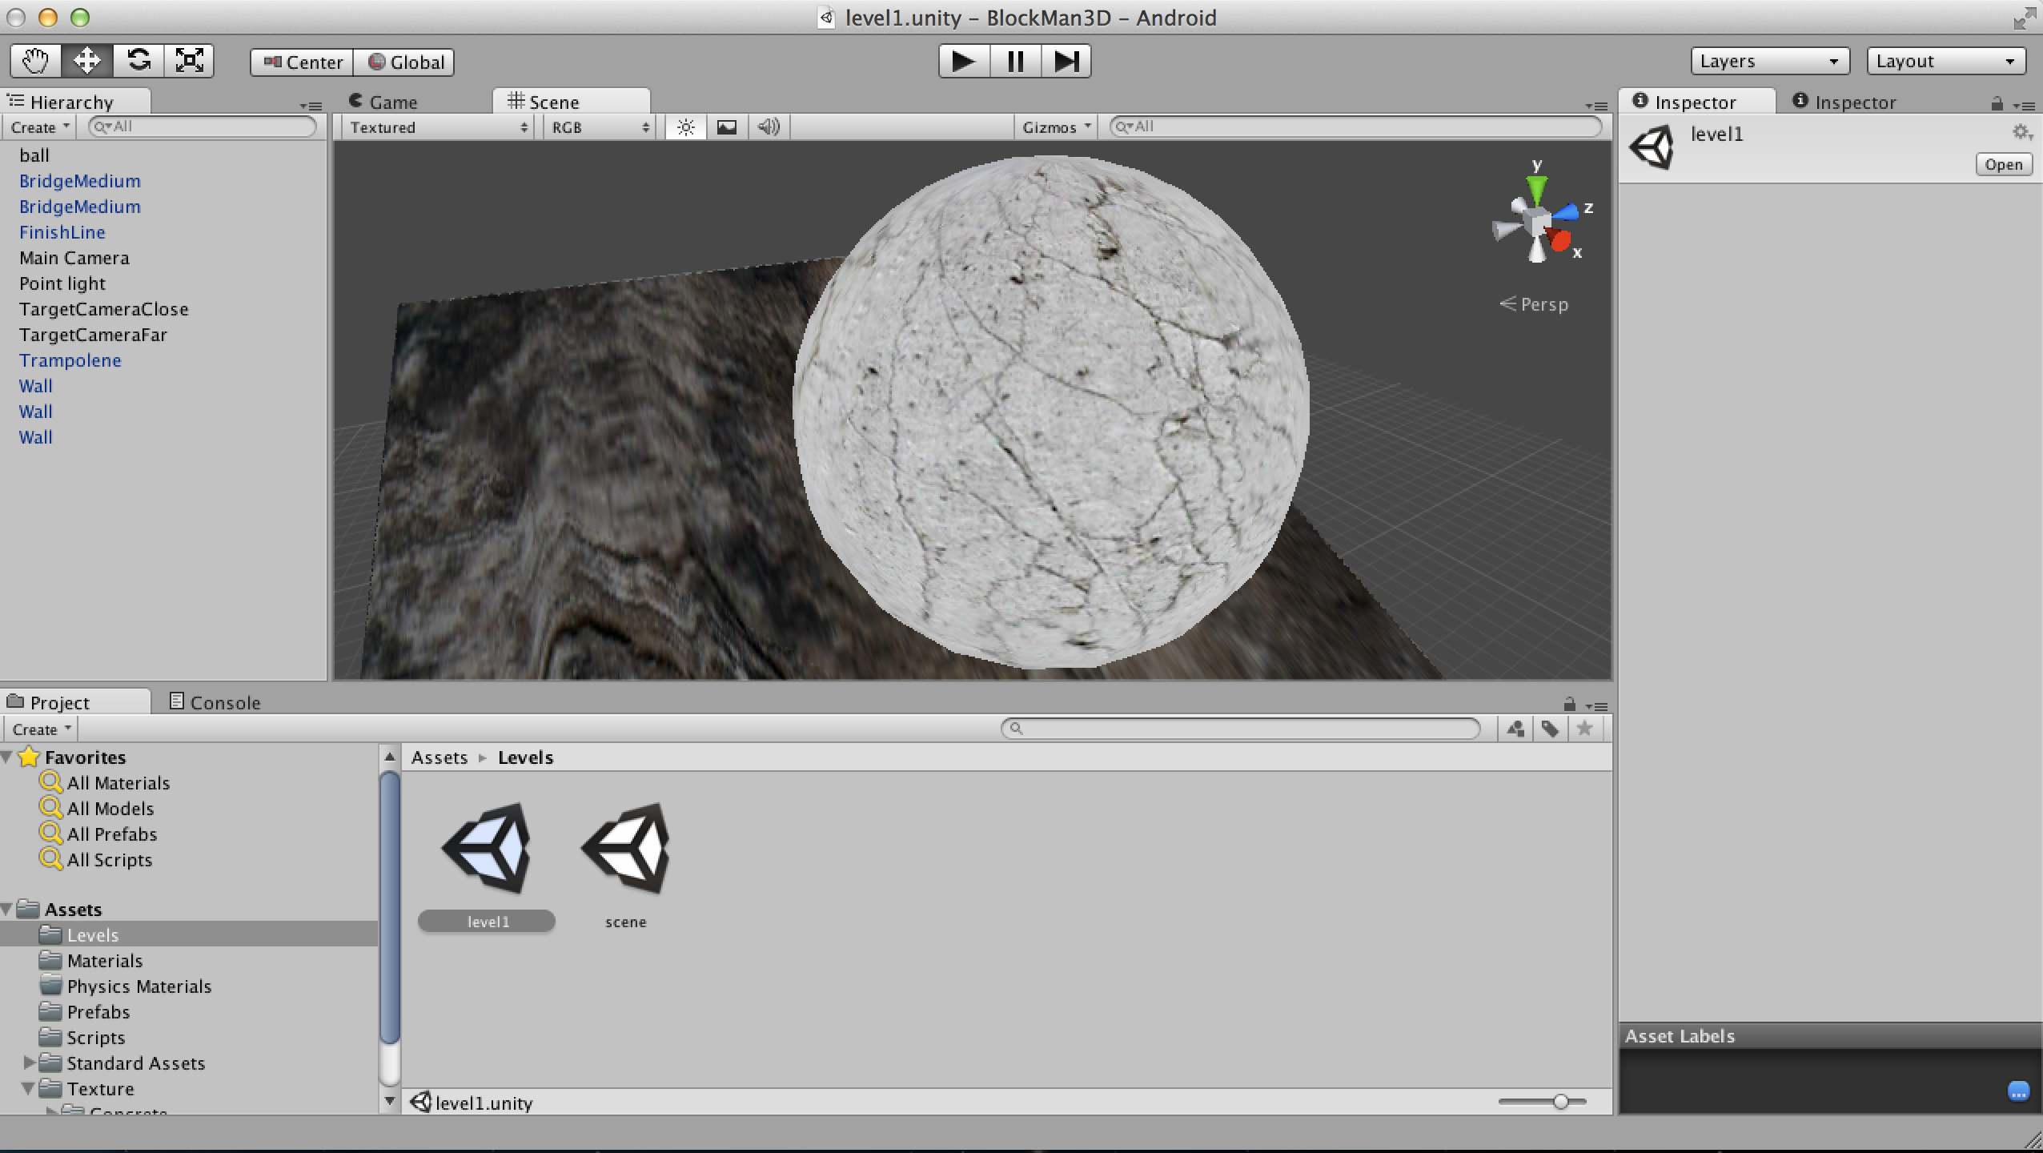
Unity 3D

Slide 5
Built In Physics Engine
Unity 3D has a built in physics engine that deals with gravity and collisions
The affects from this engine are very realistic
So how do I use the physics engine???

Slide 6
RigidBodies
In order to access Unity 3D’s powerful physics engine a you must first apply a rigidbody to the game object of choice.
Rigidbodies basically tell Unity: “Hey, I need to physically react with other game objects”
Also with Rigidbodies you can add variables such as gravity, bounce factor, vector forces, etc.
However Rigidbodies don’t know how to detect collision. So how can I tell when my object hits another object???

Slide 7
Colliders
Different type colliders:
Box Collider
Sphere Collider
Mesh Collider
Capsule Collider
Terrain Collider
Wheel Collider
Several others…

Slide 8
Colliders
Colliders are used simply to detect collisions
When a collision is detected with another collider a message is sent to the physics engine and the two colliders react accordingly.
In javascript you can also utilize the OnCollision() function.

Slide 9
What good is physics if you cant see it?

Slide 10
Cameras
Cameras capture a field in the world and translate that on to the users screen
Multiple cameras can be used but it is advised to stick with one as multiple viewing angles can be very complicated
Cameras are responsible for listening for audio.

Slide 11
Lighting
Different type of game lights:
Directional Light
Point Light
Spot Light
Area Light

Slide 12
Textures
Textures are used to give game objects color
Texture maps convert 2D textures in order to apply them to 3D game objects

Slide 13
How to deal with 3-Dimensional Coordinates?

Slide 14
Dealing with 3D location and rotation
Different variables that help deal with rotation and location
Euler’s Angles
Quaternions
Vector3’s and Coordinates
Utilizing the Slerp() and Lerp() functions
Don’t let big words scare you, all of these are easy to understand!

Slide 15
Transforms
Every gameobject has a transform that can stores the position and rotation of that gameobject
Transforms do not require colliders or rigidbodies.
Even empty game objects have transforms.
How are rotation and location stored?

Slide 16
Quaternions
Quaternions are simply a data type used to represent a rotation of a gameobject
All Quaternions have a (x,y,z) coordinate
How a quaternion might be used in java script:
function rotate()
{ var rotation: Quaternion = new Quaternion(0, 90, 0);
transform.rotation = rotation;
}
This code will set the X and Z rotation of the gameobejct transform to 0 and the Y rotation to 90.

Slide 17
Euler’s Angles
Wikipedia defines Euler’s Angles as:
“The Euler angles are three angles introduced by Leonhard Euler to describe the orientation of a rigid body”
You can alter Euler’s Angles individually or by simply passing quaternion and the rotation of the X, Y, and Z, axis will be changed accordingly.

Slide 18
Vector3’s
The position of a transform in a 3D space is stored in a Vector3
Vector3’s have an x, y, and z coordinate
Gameobject’s position can be updated directly by applying a new Vector3

Slide 19
Transform.Position
The position of a transform is represented by a Vector3
The position can be updated on a per axis bases or by simply applying a Vector3
Example of how to change a single axis on the current Vector3 position:
transform.position.x = transform.position.x + 50;

Slide 20
Getting Game Objects to Move Smoothly
To get game objects to move smoothly instead of jumping coordinates, one can utilize the the Quaternion.Slerp and the Transform.Lerp
These allow you to move form one coordinate to the next smoothly through spherical linear interpolation

Slide 21
Location and Rotation Recap
Location of a transform is stored in Vector3’s and can be updated directly by accessing the transforms rotation variables. The location can also be updated by applying a new Vector3.
Rotation of a transform is stored in quaternions and can be edited directly by accessing the Eulers Angles variables. The rotation can also be updated by applying a new Vector3.

Slide 22
Scripting in UNity3d
There are several types of scripting languages you can use in Unity3D, however, today we will be talking about javascript
Scripts are applied directly to gameobjects and “tell” them what to do

Slide 23
Java Script
With java script you have functions which are basically “chunks” of code that you can run over and over
For example, in Unity3D, the function Update() is called once every frame
Function Update()
{
print(“Hello”);
}
Assuming you game is running at 60 FPS the following function will print “Hello” in the console 60 times a second.

Slide 24
Java Script Variables
Variables are temporarily store data in an easily accessible place
The key word to make a variable is “Var”
For example to allocate memory to store the number 13, you would do the following;
var ourNumber: int = 13;
To store the string “Comp 89 is cool” you could do the following
var ourString: string = “Comp 89 is cool”;

Slide 25
Digging a little deeper into java script
//(x,y,z)
var quat: Quaternion = new Quaternion(90,90,180);
var pos: Vector3 = new Vector3(10,20,30);
transform.rotation = quat;
transform.position = pos;
print(transform.position.x);
print(transform.rotation.z);

Slide 26
Output
The output of the previous segment of java script will be:
10
180

Slide 27
UNITY3d Concept Demo

Slide 28
Questions???

Slide 29
Conclusion
Notes:
Hey everyone, how many of you have played a video game? Great, every one of you rose your hands. Today we’re going to be exploring the inner workings of video games, specifically using the game engine Unity.

